Slide 1
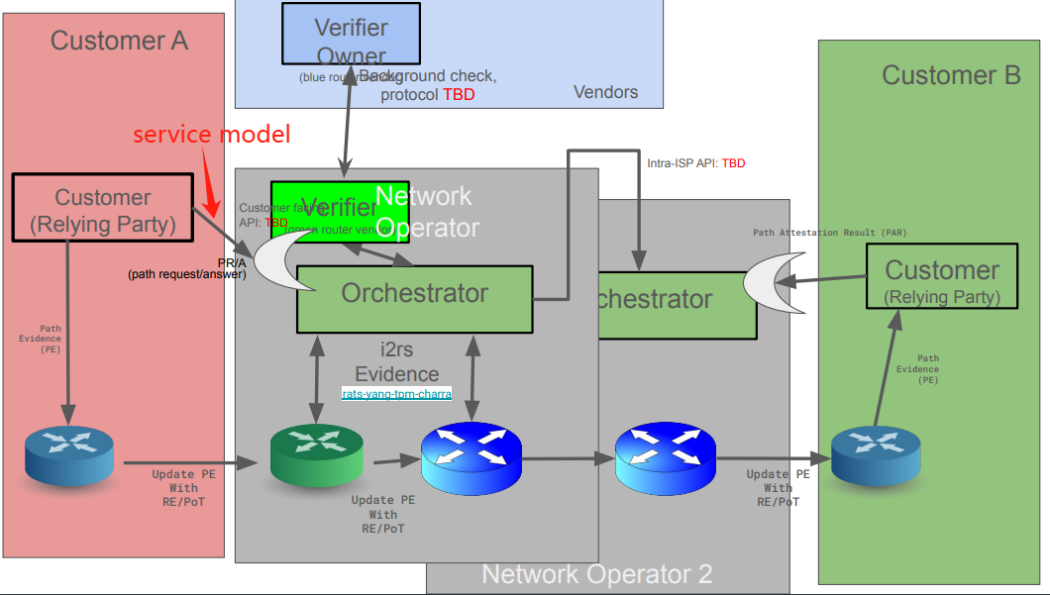
service model for NASR Operators offer security capabilities that can be added to the connectivity service, and clients make choices.

Slide 2
Customer
Orchestrator
Node
Service request model from user:
Destination,
Trusted Path Provision
Request(Security Requirements)/HTTP
Accurate security requirements
Node and Path Selection based on Trusted Path Provision parameters
Service result model to user:
Path attestation result
Response(Service result model to user)
Security Services Configuration/PCEP
Actual Forwarding
Service result model to user:
② Forwarding Path validation result
③Service provision result
Forwarding and service result/PCEP
Service result model to user

Slide 3
service model for NASR Operators offer security capabilities that can be added to the connectivity service, and clients make choices.
Service request model from customer:
Destination(lP), Path, Sevice type, Geographic restriction;
Trusted Path Provision:
Node Type: NFV or Hardware;
Node Security Configuration: the node's basic security configuration baseline possessed by the router itself, include security hardening, attack perception and so on.
L2/L3 Security Feature: used to identify whether to enable authentication and encryption on L2 or L3.(RFC8049)
Connection Reliability Feature: Maximal occupancy level, Isolation, Diversity.<RFC 9543>.
Security Services Configuration:Security services that can be provided based on traffic, such as firewall,IDS/IPS,attack-mitigation(anti-DDos), access control, Integrity Protection. Each type of security service requires two SLE parameters, processing latency and performance of security capabilities.

Slide 4
service model for NASR Operators offer security capabilities that can be added to the connectivity service, and clients make choices.
Service result model to user:
(Initial)Path attestation result: after generating a path that meets the specific forwarding requirements of the user, it is used to record the initial path attestation result as a baseline for future verification, contains at least four fields: Identity, initial attestation result, verification reference and auxillary information.
(Actual) Forwarding Path validation result: formed during the actual forwarding process both in-situ and out-of-band modes, it will be verified with path attestation result, contains at least two fields: Identity, Attestation results.
Service provision result: as security services can be provided, after the service is provided, need to provide service proof to the user, contains at least two fields: Identity, Service type, Service details.

